Slide 1
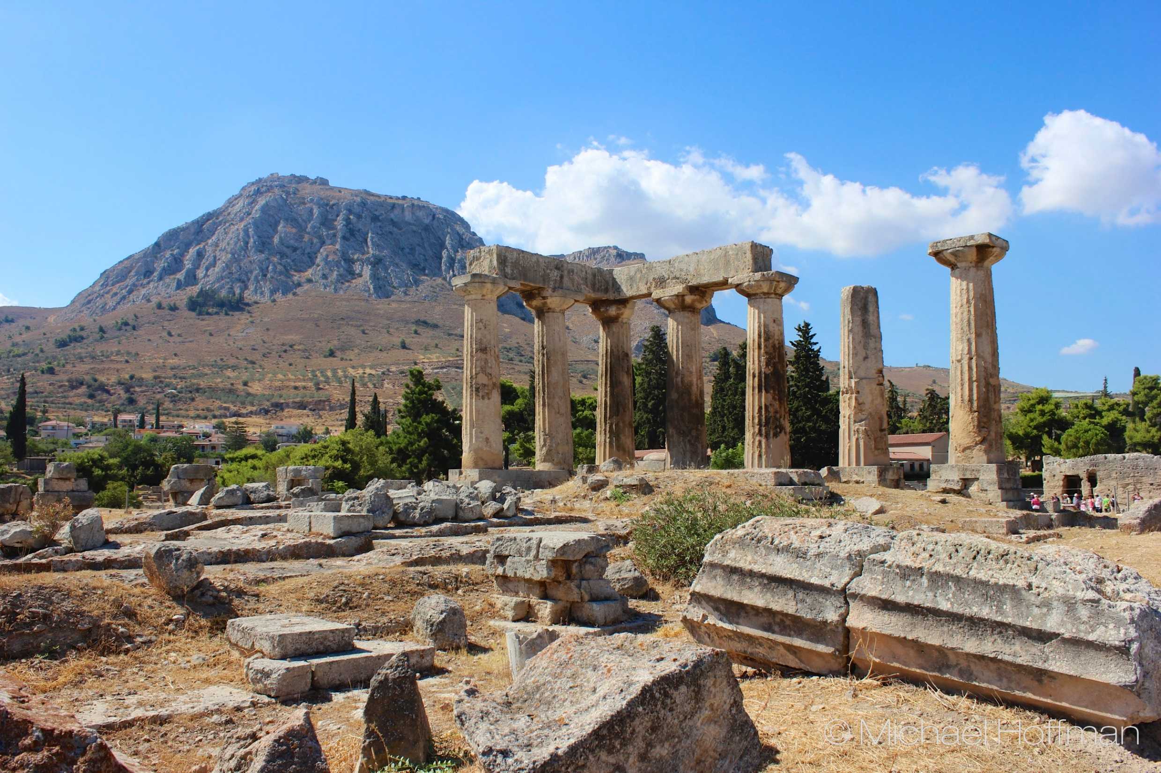
Coburg Road Church of Christ - August 25, 2019
Acrocorinth as viewed from Corinth

Slide 2
1 Cor. Chapters 10 & 11 (Idolatry, Hair, Lord’s Supper)

